Slide 1
You, then,
You will pray like this....

Slide 2
Seventh Day Baptist Week of Prayer
January 7-13, 2024
During the first full week of January since 1967, Seventh Day Baptists around the world have come together in prayer sharing theme-focused meditations chosen by the author of the Seventh Day Baptist Week of Prayer booklet. The theme for this year is, “You, Then, You Will Pray Like This.”
Purposes of the SDB World Federation include:
1. To provide increased communication among Seventh Day Baptist groups around the world.
2. To promote projects of mutual interest which will benefit from international cooperation.
3. To stimulate fellowship among Seventh Day Baptist Christians through periodic meetings of representatives between conferences or groups and programs of mutual aid.
4. To receive and evaluate statements of need as may come to the Federation and to share such expression of need with its members, inviting their response as the Lord may lead.
5. To provide leadership training for Conference leaders, pastors and lay leaders appropriate to each individual conference, as determined through consultation.

Slide 3
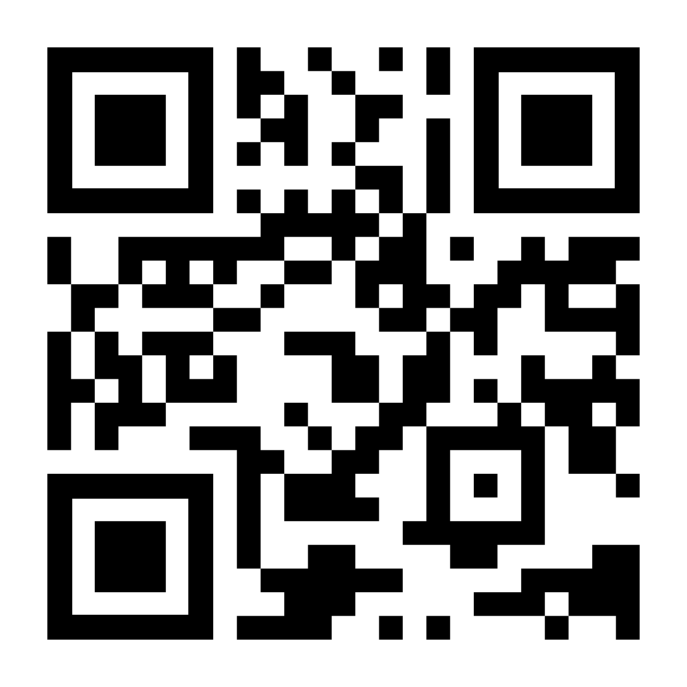
Prayer Requests by Country:
In order to help the people in our conferences pray intelligently about concerns in particular countries, a page with relevant information by country has been posted to the SDB World Federation website, and may be accessed by clicking on the following link or by scanning the QR code on the right:
https://sdbwf.org/wop/2024

Slide 4
Last General Sessions
in Blantyre, Malawi, September 16-23, 2023
The last General Sessions were held in Blantyre, Malawi, September 16-23, 2023 under the theme, “Become Perfectly One," based on John 17:23. The next General Session is planned to be carried out in 2028 at a venue to be announced.
Officers:
Officers for the World Federation include General Secretary Douglas Machado (generalsecretary@sdbwf.org); President Luciano Baretto Nogueira de Moura (president@sdbwf.org); Treasurer, Deborah Hargett (treasurer@sdbwf.org); Assistant General Secretary, Andrew Samuels; Recording Secretary, Marcia Nembhard; Regional Vice Presidents: Canaan Phiri (Africa), Abel Caesar (Caribbean), Carlene Wynter (Europe), Amaury Moitinho (South America), and Nicholas Kersten (North America). Luis Lovelace serves as Editor of Publications.

Slide 5
Treasurer’s Page
The SDB World Federation desires to further the kingdom of God and make disciples in all nations. It is a volunteer organization relying on contributions from conferences, churches and individual donors. Donations to the SDB World Federation are used to provide increased communication among SDB groups around the world, promote projects of mutual interest benefitting international cooperation, stimulate fellowship among Seventh Day Baptist Christians, and fund the operating costs of the federation, including travel expenses and conference costs of the World Federation Sessions that occurs every five years.
During the SDB World Federation Sessions in Malawi in September 2023, delegates had the opportunity to witness firsthand the needs of our largest member conference, the Central Africa Conference. Reports from other conferences around the world indicate similar needs. The World Federation aims to foster active communication and collaborative projects between member conferences to address these needs.

Slide 6
Treasurer’s Page
The World Federation encourages all member conferences to reintroduce an annual Sabbath giving week to support the World Federation. This event is recommended to take place on the last Sabbath of May each year. The theme for 2024 is "Give Freely and Increase" based on Proverbs 11:24. However, contributions and designations are welcome at any time throughout the year. To contribute, please make checks or money orders payable to SDBWF and mail them to the following address:
Treasurer, SDB World Federation, P.O. Box 581, Silver Creek, GA 30173, USA.
Alternatively, donations can be made via PayPal at treasurer@sdbwf.org or through our website at sdbwf.org/donate.
Your support and contributions play a vital role in furthering this mission. Together, we can make a significant impact in advancing God's kingdom and spreading His message to all nations.
Debbie Hargett, Treasurer, SDB World Federation

Slide 7
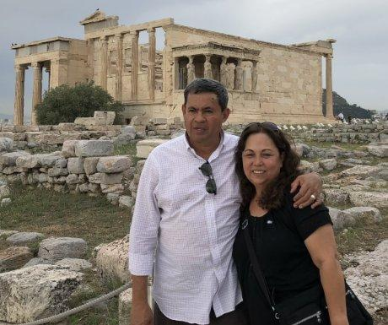
Seventh Day Baptist Week of Prayer
About the Author
Helmer Umaña is the Pastor of the Seventh Day Baptist Christian Church in Silver Spring, Maryland, USA. His nationality is Salvadoran. He studied Engineering at the National University of El Salvador and for political reasons could not finish his studies. He was a teacher in private schools in his country. He married Anna Vilma 45 years ago in El Salvador and together they have two children: Karen who was the recording secretary for the World Federation, and Helmer Jr. who pastors a Seventh Day Church of God in the San Jose, California area. Helmer Jr. is married to Liz, a faithful servant of God and they are parents of a beautiful 3-year old daughter named Getsy.

Slide 8
Seventh Day Baptist Week of Prayer
Introduction
The most sacred, delicate, and purest things of the spiritual life are generally the things which tend to be attacked, or damaged, and sometimes misrepresented. And we as Christians sometimes end up believing, accepting, and often using them. I was captivated that some of the apostles asked the Lord to teach them to pray. Perhaps they were impressed by His way of praying, or by the effectiveness of how Jesus Christ did it. Although we were not allowed to know how John taught his disciples, but I can safely say that we have no record that John taught them to say, "Our Father."
Looking at Matthew's context in Chapter six, we see that the Lord takes the time to teach first. what to do, and what not to do regarding the themes of Giving, Prayer and Fasting. It seems that those disciplines were being practiced in the wrong way. Some of those who gave, made sounds like trumpets; some of those who prayed, did it standing in the synagogue or on the corners to be seen and some of those who fasted, disfigured their faces, to cause a look of piety.
I believe that the tone of our Lord in these passages is not casual, but it can carry the intention of establishing people who can really pray, with a more real, and clear intention. Jesus wanted them to utilize elements that were being left out of something so sacred as prayer is. For that reason, when our Lord says "This, then is how you should pray,” He is not making a suggestion. The expression itself denotes a command, from the highest spiritual authority.

Slide 9
Seventh Day Baptist Week of Prayer
Introduction
For us Christians, praying is not an option. Being a Christian involves not only following Jesus, but even more, to know Him and maintain constant dialogue with Him. Prayer is intrinsic to Christianity. Believing in Jesus as our Lord and Savior leads us to have an ongoing personal relationship with Him.
It is mandatory to know the meaning of what we pray as Christians, and understand some fundamental concepts that help us to have a constant relationship with God in an appropriate way.
Normally when we talk about spirituality, we think of prayer. By saying that a person is spiritual, we are usually referring to someone who has frequent personal contact with God. But spirituality goes beyond simply praying. It involves every moment of our existence. Christian spirituality is indeed based on how we relate to God, but also in how we reflect Christ.
It is necessary to understand the importance that Jesus Christ highlighted to each of the elements that are part of His prayer. In Matthew chapter 6 for example, He uses the term, "Your Father," and He is not saying that in a general way to all men, but giving it to His disciples. And after using it for more than three occasions, He then teaches that we can use it also and begin our prayers with the sublime expression: "Our Father, who art in heaven."
I want to use those elements in this Week of Prayer, with the intention that they serve us, not only to improve our prayer life, but to improve our overall relationship with God.

Slide 10
You, then, pray like this....
Sunday, January 7, 2024
It came to pass that Jesus was praying in a place, and when He finished, one of His disciples said to Him: Lord, teach us to pray, as John also taught his disciples. Luke 11:1

Slide 11
Sunday, January 7, 2024
Edit this slide to add the any text you'd like to share. You may also delete it.

Slide 12
Sunday, January 7, 2024
Application to our life
What necessary implication does Jesus consulting with His Father about all things, have for us?
Are we people of prayer?

Slide 13
Sunday, January 7, 2024
Today we will pray for Seventh Day Baptists in the countries of:
Angola, Australia*, Bangladesh, Brazil*, Burundi*,
Cameroon, Canary Islands
*Conferences which are members of the Seventh Day Baptist World Federation

Slide 14
You, then, pray like this....
Monday, January 8, 2024
He said to them, “When you pray, say, ‘Our Father... Luke 11:2a

Slide 15
Monday, January 8, 2024
Edit this slide to add the any text you'd like to share. You may also delete it.

Slide 16
Monday, January 8, 2024
Application to our life
By directing our prayers to God as our Father, we should think of tenderness and love that characterize a Father when He talks to His children.

Slide 17
Monday, January 8, 2024
Today we will pray for Seventh Day Baptists in the countries of:
Canada*, Chile*, Colombia, Cuba*, Ecuador*,
Egypt, Democratic Republic of Congo
*Conferences which are members of the Seventh Day Baptist World Federation

Slide 18
You, then, pray like this....
Tuesday, January 9, 2024
And the Lord said, “Hear what the unjust judge said. And won’t God do justice to His chosen, who cry out to him day and night?
Will He take time to respond to them?”
Luke 18:6-7

Slide 19
Tuesday, January 9, 2024
Edit this slide to add the any text you'd like to share. You may also delete it.

Slide 20
Tuesday, January 9, 2024
Application to our life
How meaningful is God’s amazing relationship as our eternal Father to us?
Can we learn the value of prayer as communication with Him, or is prayer for us nothing more than a request for help in a time of emergency?

Slide 21
Tuesday, January 9, 2024
Today we will pray for Seventh Day Baptists in the countries of:
England*, Ethiopia, Gambia, Ghana*, Guinea,
Guyana*, Haiti
*Conferences which are members of the Seventh Day Baptist World Federation

Slide 22
You, then, pray like this....
Wednesday, January 10, 2024
But the publican, being far away, did not even want to raise his eyes to heaven, but he beat his chest, saying, “God, be merciful to me, a sinner.”
I tell you that this one descended to his house justified before the other, because anyone who exalts himself will be humiliated and he who humbles himself will be exalted. Luke 18:13-14

Slide 23
Wednesday, January 10, 2024
Edit this slide to add the any text you'd like to share. You may also delete it.

Slide 24
Wednesday, January 10, 2024
Application to our life
Do we come to our Father as empty people, needing and waiting for Him with our weaknesses and insufficiency?
Do we come to understand the true meaning of “mercy,” acknowledging it with deep gratitude and humble repentance?

Slide 25
Wednesday, January 10, 2024
Today we will pray for Seventh Day Baptists in the countries of:
India*, Indonesia, Ivory Coast, Jamaica*, Kenya*,
Lebanon, Liberia
*Conferences which are members of the Seventh Day Baptist World Federation

Slide 26
You, then, pray like this....
Thursday, January 11, 2023
Forgive us our sins, for we also forgive all who offend us. Luke 11:4a

Slide 27
Thursday, January 11, 2023
Edit this slide to add the any text you'd like to share. You may also delete it.

Slide 28
Thursday, January 11, 2023
Application to our life
Are we blocking the fullness and freedom of God’s forgiveness of our sins by refusing to extend to others the same grace of forgiveness that God has made available to us?

Slide 29
Thursday, January 11, 2023
Today we will pray for Seventh Day Baptists in the countries of:
Malawi*, Mozambique, Netherlands*, New Zealand*, Nicaragua,
Nigeria*
*Conferences which are members of the Seventh Day Baptist World Federation

Slide 30
You, then, pray like this....
Friday, January 12, 2024
Therefore, we too, from the day we heard it,
did not cease to pray for you. Colossians 1:9a

Slide 31
Friday, January 12, 2024
Edit this slide to add the any text you'd like to share. You may also delete it.

Slide 32
Friday, January 12, 2024
Application to our life
Think of someone who needs your spiritual help, and make a short prayer to God for that person.
Someone will then take you in their prayers, and suddenly you will feel the relief you need. Lord, teach me the secret of continual prayer. Help me to see every event and every person in my life as an invitation to pray.

Slide 33
Friday, January 12, 2024
Today we will pray for Seventh Day Baptists in the countries of:
Pakistan, Philippines*, Poland*, Rwanda*, Sierra Leone,
South Africa, South Korea
*Conferences which are members of the Seventh Day Baptist World Federation

Slide 34
You, then, pray like this....
Sabbath, January 13, 2024
In my guard post I will be, on the fortress I will affirm my foot. I’ll watch to see what He will tell me, and what I have to answer about this complaint. Habakkuk 2:1

Slide 35
Sabbath, January 13, 2024
Edit this slide to add the any text you'd like to share. You may also delete it.

Slide 36
Sabbath, January 13, 2024
Application to our life
Are we responding as Habakkuk did, waiting expectantly for more complete understanding? What are three possible ways this can play out? While we wait, are we content to trust God, realizing that He has the whole picture, while we only have limited vision? And sometimes the circumstances around us further limit our understanding and dictate our reactions. God said, “Cry out to Me, and I will answer you, and I will teach you great and hidden things you do not know.” Jeremiah 33: 3.

Slide 37
Sabbath, January 13, 2024
Today we will pray for Seventh Day Baptists in the countries of:
South Sudan, Tanzania, Uganda*, Ukraine, Zambia*,
United States of America*
*Conferences which are members of the Seventh Day Baptist World Federation

